Slide 1

All About Phonics
Lea Community Primary School

Slide 2

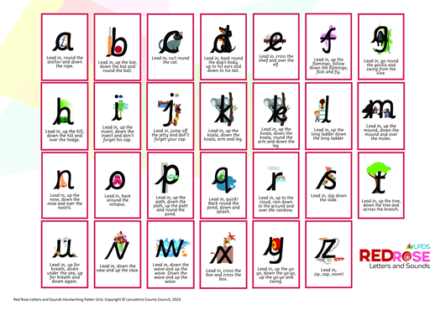
Introducing phonics
At Lea Community Primary School, we follow the Red Rose letters and sounds scheme.​The Red Rose Letters and Sounds scheme is a systematic phonics program designed to support the teaching and learning of phonics in early years and primary education. It is based on the Letters and Sounds approach and has been developed by the Lancashire Professional Development Service. The program includes planning from Phase 2 to Phase 5, with specific daily sessions and a rigorous approach to meet and exceed expectations based on the Early Learning Goals and the National Curriculum for Year One. It aims to strengthen phonics teaching and ensure children become enthusiastic and successful readers and writers. The program is not DFE validated, allowing schools to choose the best publishers for each phonics phase.
​

Slide 3

What is phonics?
Phonics helps children to learn how to read and write, paving the way for an enjoyable and successful school experience.​
​
Phonics helps children to develop good reading and spelling skills​ e.g. cat can be sounded out for reading and spelling.
​

Slide 4

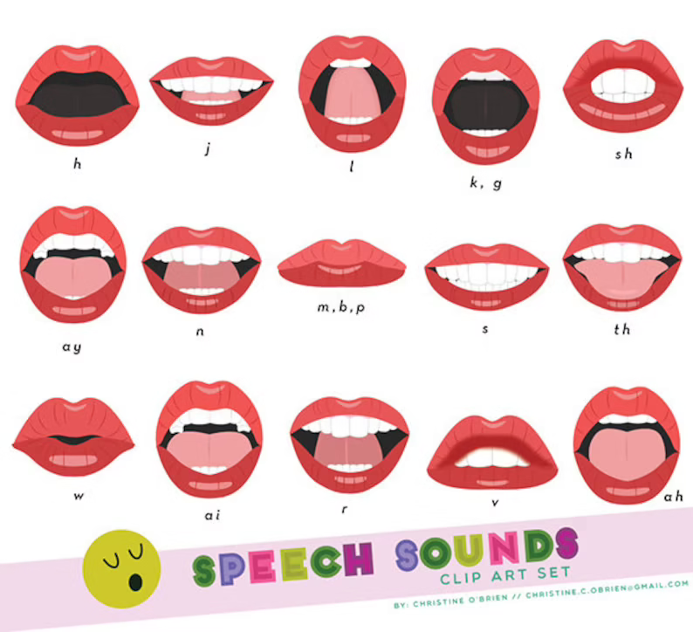
The 44 Phonemes:
/b/ | /d/ | /f/ | /g/ | /h/ | /j/ | /k/ | /l/ | /m/ | /n/ | /ng/
/p/ | /r/ | /s/ | /t/ | /v/ | /w/ | /y/ | /z/ | /th/ | /th/ | /ch/
/sh/ | /zh/ | /a/ | /e/ | /i/ | /o/ | /u/ | /ae/ | /ee/ | /ie/ | /oe/
/ue/ | /oo/ | /ar/ | /ur/ | /au/ | /er/ | /ow/ | /oi/ | /air/ | /ear/ | /ure/

Slide 5

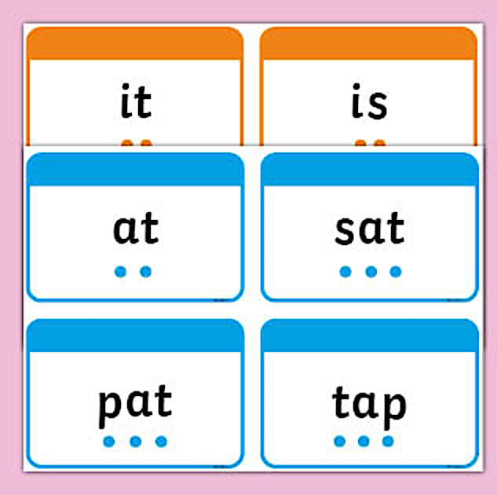
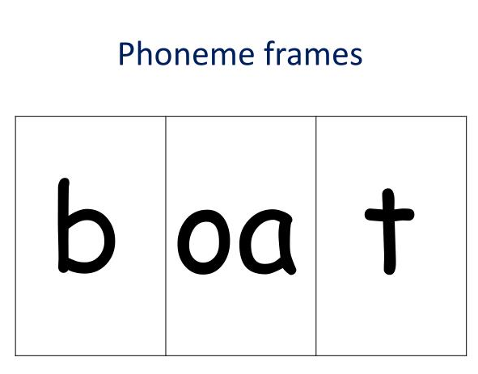
Strategies to support reading
Schools select certain strategies to help children learn how to read and write and using these strategies at home will allow children to make links within their learning and help them to make progress in their reading and writing.
Phonics fingers to count how many sounds a word has.
Sound buttons to support reading words.
A phoneme frame helps children to see how many sounds are in a word.

Slide 6


Terminology
Phonics terminology can be confusing for parents as well as children! This will hopefully help you with any unfamiliar words so that you can support your child at home.
Phoneme
A phoneme is the smallest unit of sound within a word. For example, in the word ‘cat’, there are three phonemes: /c/ /a/ /t/. In later phases, phonemes can be represented by more than one letter, for example, in the word ‘bath’, there are three phonemes: /b/ /a/ /th/ - the /th/ phoneme is represented by a grapheme containing two letters.
Grapheme
It is the written representation of a phoneme. Children need to practise recognising the grapheme and saying the phoneme that it represents. The grapheme could be 1 letter, 2 letters or more!

Slide 7

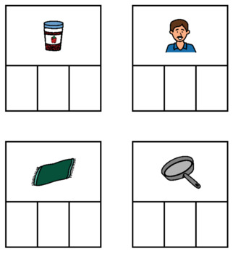
Terminology
Phonics terminology can be confusing for parents as well as children! This will hopefully help you with any unfamiliar words so that you can support your child at home.
Blending
Blending is merging the individual sounds in a word in order to read the whole word. For example, we can blend the sounds /f/ /i/ /sh/ to make the word ‘fish’.
Segmenting
Segmenting is a skill used in writing and spelling. It means breaking up a word into its individual sounds to be able to then write those sounds down in the correct order. Children are sometimes taught to count the phonemes (individual sounds) they can hear in a word to help them to make sure they represent each sound when attempting to write it.

Slide 8

Terminology
Phonics terminology can be confusing for parents as well as children! This will hopefully help you with any unfamiliar words so that you can support your child at home.
Tricky words
Words that are not phonically decodeable
e.g. was, the, I
Some are ‘tricky’ to start with but will become decodeable once we have learned the harder phonemes
e.g. out, there
Digraph/ Trigraph
Digraph- two letters to make one sound- ch, sh, ng
Trigraph- three letters to make one sound- igh, dge

Slide 9
National expectations-Trajectory
 | Nursery | Reception | Year One | Year Two
Autumn | Phase 1 | Phase 1 Phase 2 | Phase 4/5 | Review Phase 5 Phase 6
Spring | Phase 1 | Phase 3 | Phase 5 Y1 spelling NC | Y2 spelling NC
Summer | Phase 1 (2 for some) | Phase 3/4 | Phase 5 Y1 spelling NC | Y2 spelling NC

Slide 10
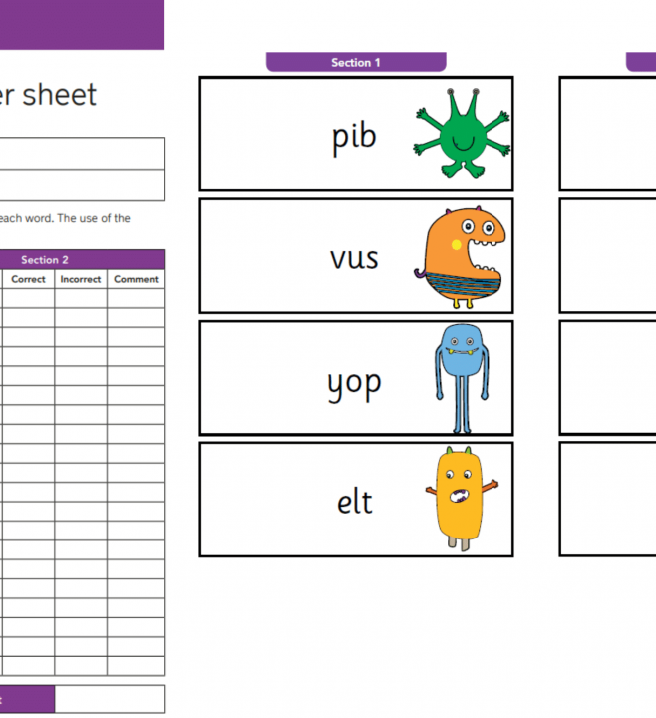
Phonics screening
Children in Year 1 throughout the country will all be taking part in a phonics screening check during the same week in June.
Children in Year 2 will also take the check if they did not achieve the required result when in Year 1 or they have not taken the test before.
Headteachers should decide whether it is appropriate for each of their pupils to take the phonics screening check.
The phonics screening check is designed to confirm whether individual children have learnt phonic decoding and blending skills to an appropriate standard.

Slide 11
What happens during the screening?
The screening contains 40 words.
Each child will sit one-to-one and read each word aloud to a teacher.
The screening will take approximately 10 minutes per child, although all children are different and will complete the check at their own pace.
The list of words the children read is a combination of 20 real words and 20 pseudo words (nonsense words).

Slide 12
Fun games to help...
I Spy (Sounds Version) | Sound Hunt | Robot Talk
“I spy with my little eye something beginning with sss.” | Look around the house for objects with a chosen sound (e.g. sh, ch, ai). | Say words like a robot (c–a–t) and ask your child to blend the sounds.

Slide 13
Fun games to help...
Jump the Sounds | Phonics Bingo | Treasure Hunt
Write sounds on paper and place them on the floor. Jump to blend a word. | Call out sounds and let your child cover them on a homemade board. | Hide words or sounds around the house for your child to find and read.

Slide 14
Fun games to help...
Tricky Word Snap | Read and Spot | Phonics Pop
Match pairs of tricky words using homemade cards. | While reading, challenge your child to spot a certain sound on each page. | Write sounds on paper, scrunch them into balls and pop one to read the sound.

Slide 15

Helpful tips
Keep reading sessions short and fun – little and often works best.
Focus on the sounds letters make, not their names (e.g. “sss” not “es”).
Encourage your child to say sounds out loud and blend them together.
Praise effort, not just correct answers.
Revisit tricky sounds regularly – repetition builds confidence.
Use everyday moments (shopping, cooking, walking) to spot sounds.
Model sounding out words when you read together.
Don’t rush your child – give them time to think and blend.
Encourage your child to “have a go” before helping.
Make mistakes normal – phonics takes practice.
Read phonics-based books matched to your child’s stage.
Ask your child to spot sounds they already know in books or signs.
Practise tricky words little and often.
Keep sessions upbeat – stop if your child becomes tired or frustrated.

Slide 16
thank you
Please do not hesitate to ask if you have any questions

